Slide 1
HOW TO APPLY FOR A
PROFESSIONAL ACCOUNT
SAUSALITO eTRAKiT

Slide 2
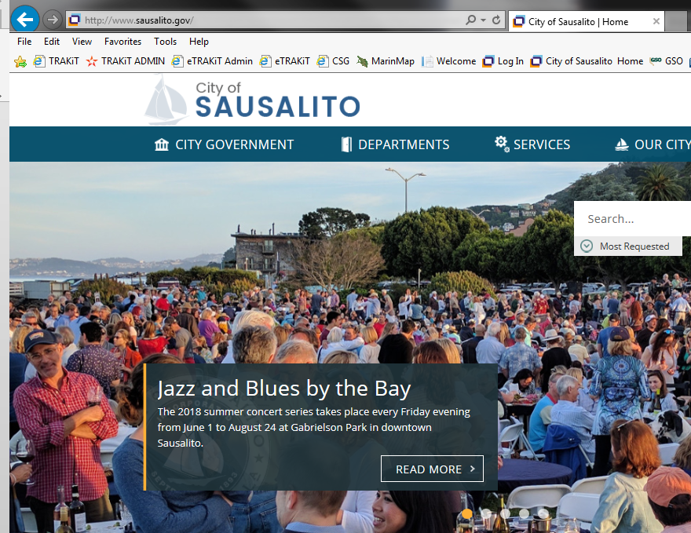
1. Go to the City of Sausalito’s website at www.sausalito.gov

Slide 3
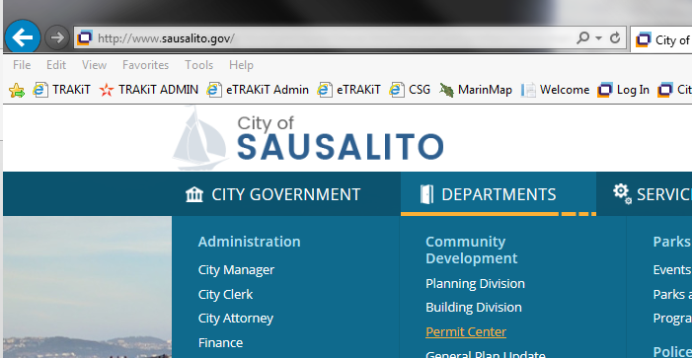
2. Under “Departments”, in the Community Development section, click on “Permit Center”.
PLACE MOUSE OVER TO OPEN SCROLL LIST
CLICK HERE

Slide 4
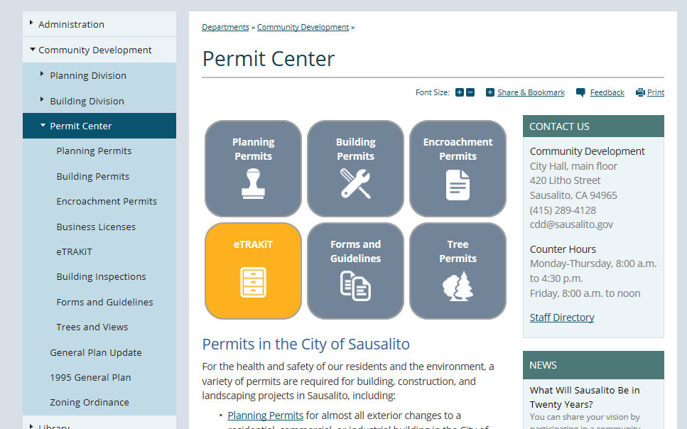
3. Under “Permit Center”, click on the “eTRAKiT” icon box.

Slide 5
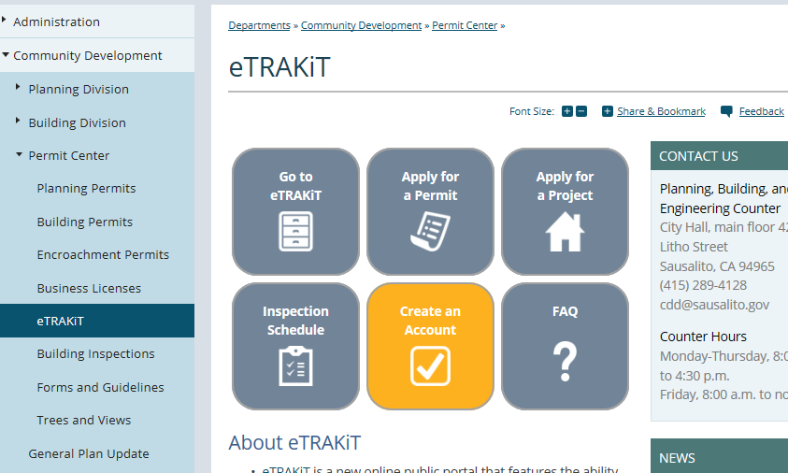
4. Through the eTRAKiT information page, click the “Create an Account” icon box.

Slide 6
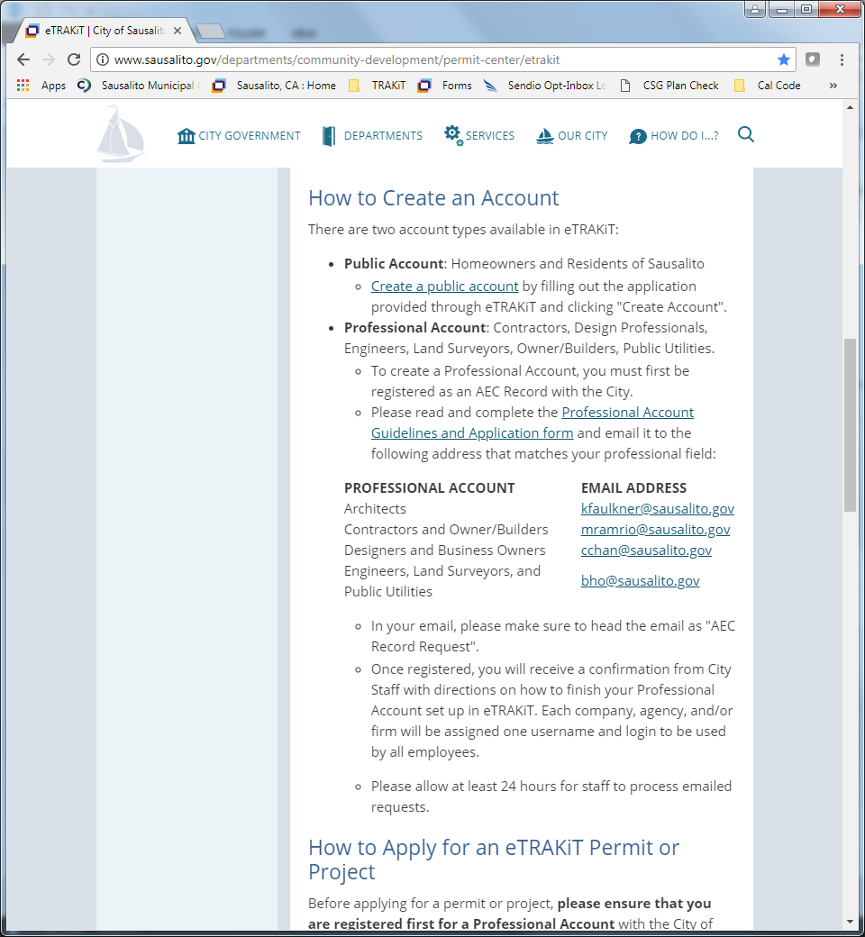
5. Click Link
Select “Professional Account Guidelines and Application form”

Slide 7
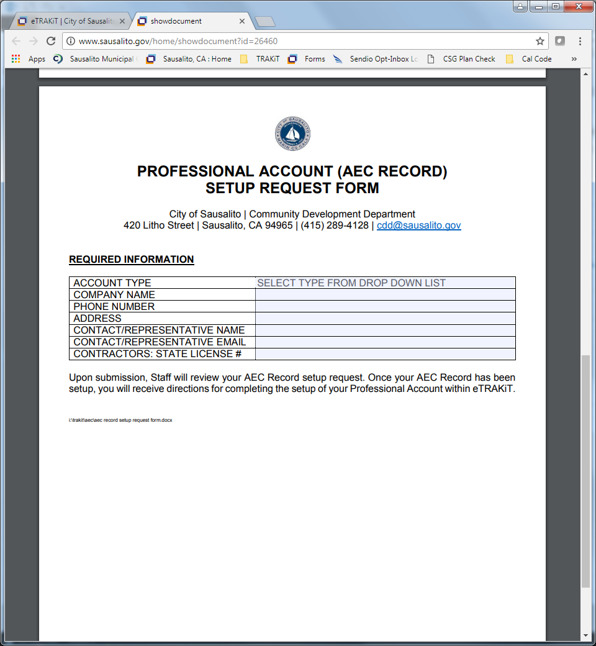
6. Setup Request Form
Read setup guidelines and fill out the Professional Account Application form

Slide 8
7. Send form to City Staff
Email the Professional Account Application form to the appropriate contact

Slide 9
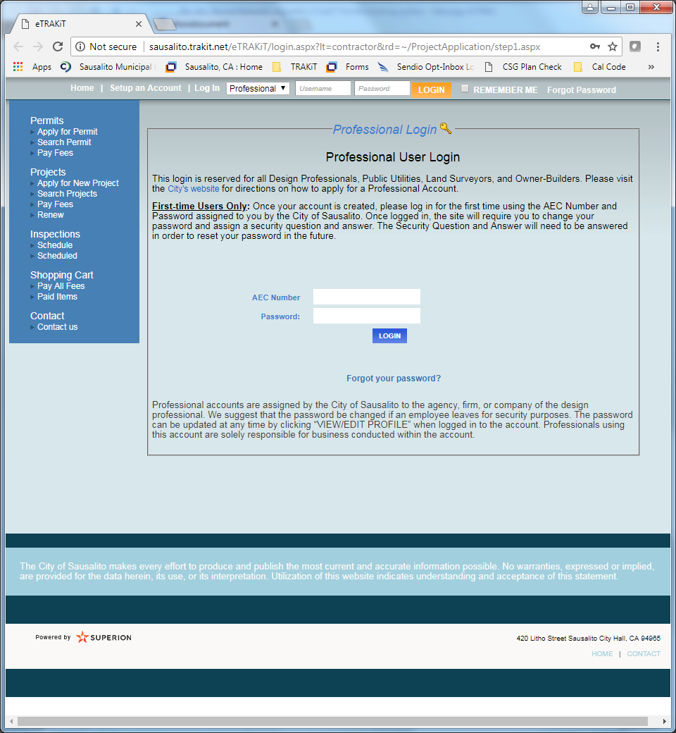
8. Login and being using account!
After you email the Professional Account Application form, City Staff will email you a link to the eTRAKiT login page, your AEC number and a temporary password
Go to the eTRAKiT login page, log in using the AEC Number and temporary password, and follow the instructions on the screen to create a new password

