Slide 1
Strategic Marketing
Proposal
Sausalito Hospitality Business Development Committee

Slide 2
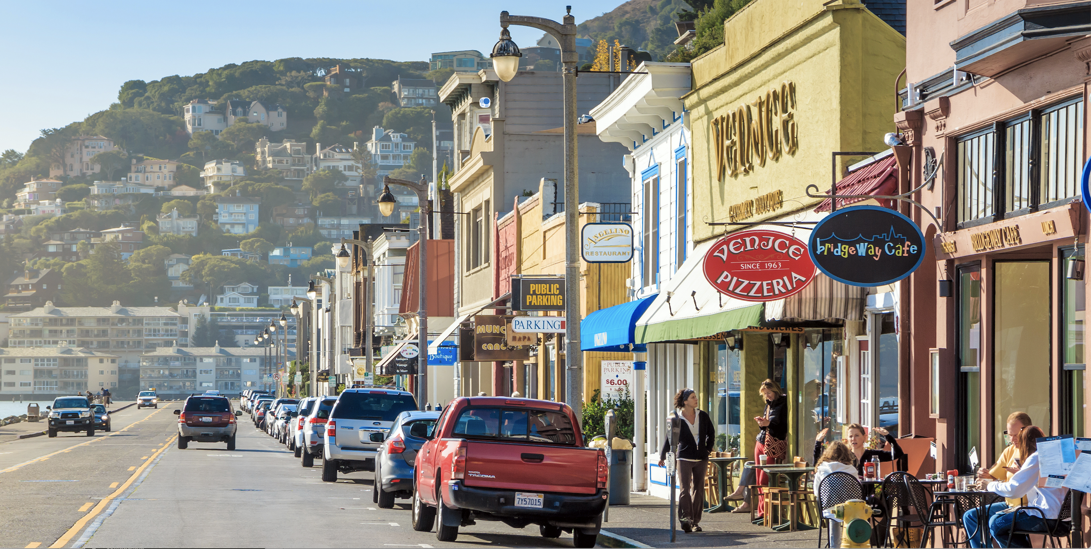
Enhancing the Visitor Experience

Slide 3
Background
The tourism industry is an important part of the City’s economy.
The city is already a vibrant destination during peak travel season and good weather, drawing visitors from around the world who come to experience the art galleries, restaurants, bars, waterfront, and the Marin headlands. The city is famous both nationally and internationally for the Art Festival held each Labor Day weekend.
To drive incremental revenue, the Hospitality Business Development Committee is requesting to earmark funds from the increased Transient Occupancy Tax. These funds will be used to create and implement a long-range, strategic marketing plan that will focus on high-revenue visitors during off-peak times, i.e. winter and mid-week, Monday - Thursday.

Slide 4
City Goals
This aligns with the first stated goal in the 2018 – 2020 Strategic Plan :
  Utilize long-range comprehensive planning, including land use and transportation, to balance the community's character and diversity with its evolving needs.
And this goal from the 2018 General Plan Update:
  Recognizing their importance to Sausalito’s economic vitality, encourage businesses and activities that have high municipal revenue generation potential and low environmental impact.
An important metric in the high value/low impact equation is City revenues per hotel key. At the May, 2018 GPAC meeting, it was reported to be about $12,000 per key, by far the most positive contribution to the City per a visitor.

Slide 5
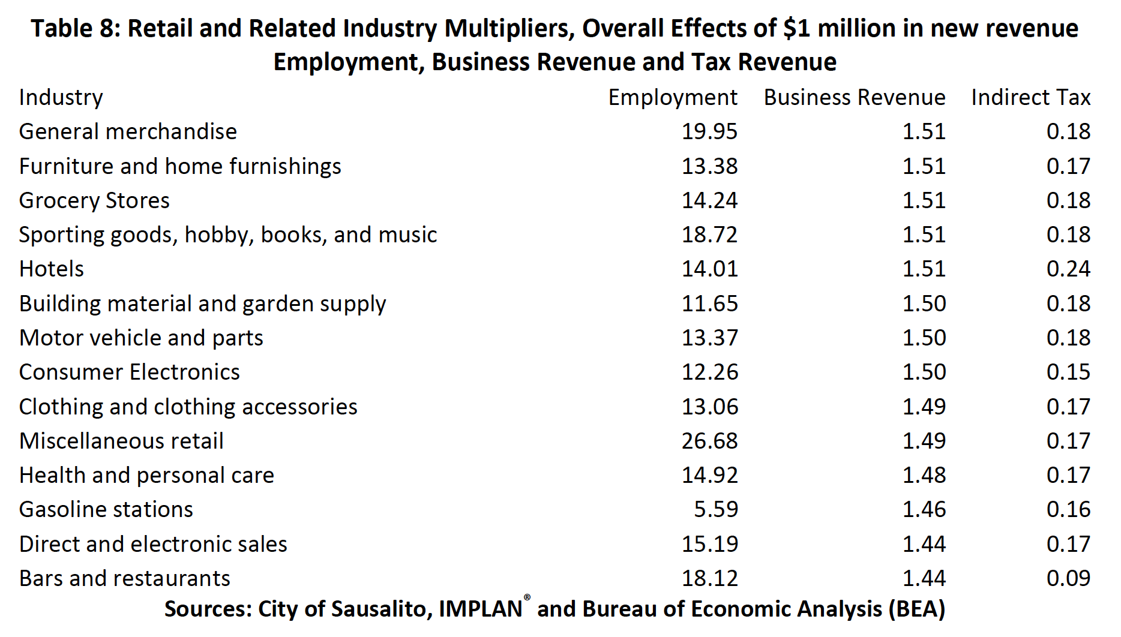
2010 Economic Survey

Slide 6
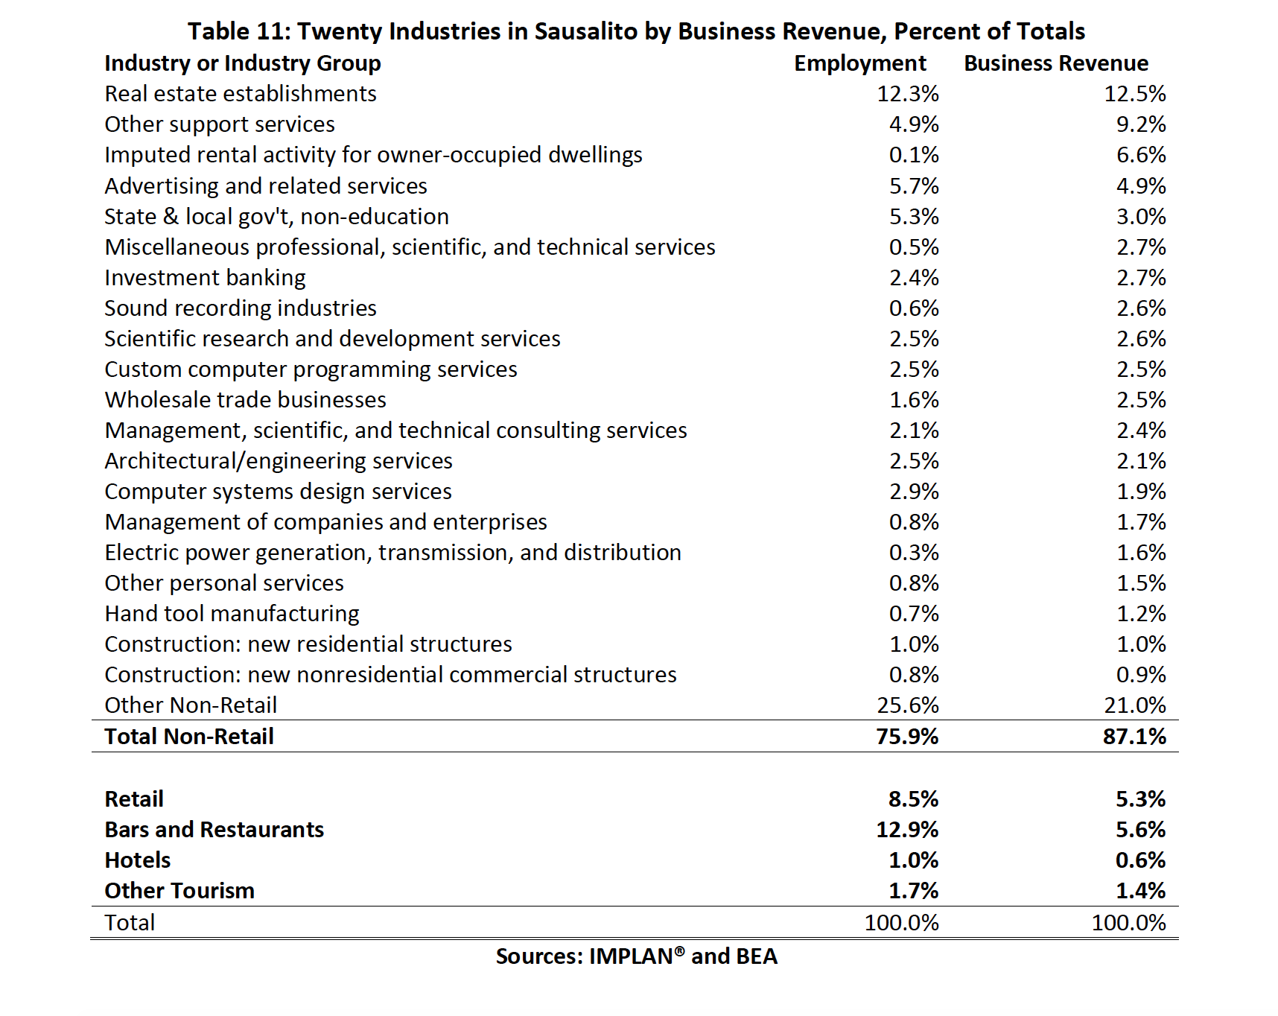
2010 Economic Survey

Slide 7
Background
The Hospitality Business Development Committee created DestinationSausalito.com, funded by the City and designed specifically to attract more mid-week, corporate visitors.
Destination Sausalito has an active presence on Facebook and Instagram.
Now it’s time to build on the Destination Sausalito foundation, enhance the site to target more sophisticated visitors, to tell the full story of the Sausalito experience and to integrate Destination Sausalito with the city’s other marketing initiatives, content and campaigns.

Slide 8
Background
To stay competitive with other coastal destinations in this digital age, The City of Sausalito must undertake sustained, comprehensive and consistent marketing efforts.
In order to generate the revenue needed to bolster the economy, it is necessary to move from short-term tactics and one-off campaigns to a long-range strategic marketing plan.

Slide 9

Target Market
High Value / Low Impact
Affinity with Luxury Brands
Visitors to Napa, Sonoma and Carmel

Slide 10
Five Pillars
To more clearly define the city as a destination, the committee has chosen five key attributes to focus on in marketing campaigns.
Arts + Culture
Food + Beverage
Health + Wellness
Festivals + Events
Experiential Venues

Slide 11
Promoting the Pillars – Two Phase Approach
The committee is requesting funds to create and implement a three-year strategic marketing plan.
The committee recommends an integrated approach that weaves together DestinationSausalito.com, VisitSausalito.org and Sausalito.org, along with collateral, guides and other print materials.
This integrated approach will help to define the Sausalito brand, make it consistent and recognizable across multiple marketing touchpoints.
From here we will engage in marketing campaigns and sales efforts.

Slide 12
Deliverables: 2019 - 2020
Documentation of Discovery Phase
Content Strategy Review, Plan and Curated Content
Website Recommendations and Updates
Vendor Vetting, Engagement and Management
Advertising Recommendations and Campaign Execution
Festival and Event Recommendations
Analytics
Discover
Design
Deliver
Develop
Deploy

Slide 13
Budget Request: $200,000
($50,000 FY 19, $150,000 FY20)
Category | Percentage
Professional and Legal | 46 %
Marketing and Advertising | 40 %
Website Expense | 10 %
Travel | 03 %
General and Administrative | 01 %
 | 100 %

Slide 14
Return On Investment
2010 Sausalito Community and Economic Development Study:
Restaurants generate an additional $440,000 for every $1 million of revenue they create approximately and $86,100 of tax revenue as well.
For hotels, $1 million of new revenue creates 14 new jobs, $510,000 of business revenue for other companies, and approximately $240,000 in business‐related tax revenues.
Note: The ROI will actually be higher than this because of the increase in TOT and Sales tax. Room key revenue has also increased.

